Slide 1
Data Mining Clustering & Association

Slide 2
Clustering

Slide 3
What is Clustering?
Cluster: a collection of data objects
Similar to one another within the same cluster
Dissimilar to the objects in other clusters
Cluster analysis
Grouping a set of data objects into clusters
Clustering is unsupervised classification: No predefined classes
Typical applications
To get insight into data distribution
As a preprocessing step for other algorithms

Slide 4
What Is a Good Clustering?
A good clustering method will produce clusters with
High intra-class similarity
Low inter-class similarity
The quality of a clustering result depends on both the similarity measure used by the method and its implementation

Slide 5
Requirements for Clustering in Data Mining
Scalability
Ability to deal with different types of attributes
Discovery of clusters with arbitrary shape
Minimal domain knowledge required to determine input parameters
Ability to deal with noise and outliers
Insensitivity to order of input records
Robustness wrt high dimensionality
Incorporation of user-specified constraints
Interpretability and usability

Slide 6
Major Clustering Approaches
Partitioning approach:
Construct various partitions and then evaluate them by some criterion, e.g., minimizing the sum of square errors
Typical methods: k-means, k-medoids.
Hierarchical approach:
Create a hierarchical decomposition of the set of data (or objects) using some criterion
Typical methods: Agglomerative, Diana, BIRCH
Density-based approach:
Based on connectivity and density functions
Typical methods: DBSACN, OPTICS

Slide 7
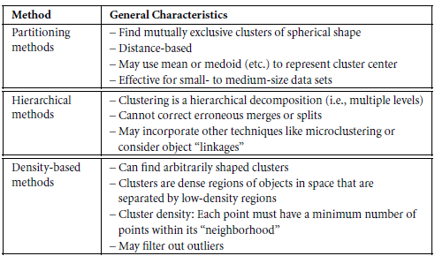

Slide 8
Partitioning Algorithms
Partitioning method: Construct a partition of a database D of n objects into a set of k clusters
Given a k, find a partition of k clusters that optimizes the chosen partitioning criterion
k-means (MacQueen, 1967): Each cluster is represented by the center of the cluster
k-medoids or PAM (Partition around medoids) (Kaufman & Rousseeuw, 1987): Each cluster is represented by one of the objects in the cluster

Slide 9
K-Means Clustering
Given k, the k-means algorithm is implemented in four steps:
Partition objects into k nonempty subsets
Compute seed points as the centroids of the clusters of the current partition (the centroid is the center, i.e., mean point, of the cluster)
Assign each object to the cluster with the nearest seed point
Go back to Step 2, stop when no more new assignment

Slide 10
K-Means Clustering (contd.)
Example
10
10
9
9
8
8
7
7
6
6
5
5
4
Assign each objects to most similar center
Update the cluster means
4
3
3
2
2
1
1
0
0
0
1
2
3
4
5
6
7
8
9
10
0
1
2
3
4
5
6
7
8
9
10
K=2
Arbitrarily choose K object as initial cluster center
10

Slide 11
K-means Example
For simplicity, 1-dimensional data and k=2.
Data: 1, 2, 5, 6, 7
K-means:
Randomly select 5 and 6 as initial centroids;
=> Two clusters {1, 2, 5} and {6,7};
mean C1=8/3 = 2.66 & mean C2=6.5
=> {1,2}, {5,6,7};
mean C1=1.5 & mean C2=6
=> No Change

Slide 12
Comments on the K-Means Method
Strengths
Relatively efficient: O(nkt), where n is # objects, k is # clusters, and t is # iterations. Normally, k, t << n.
Weaknesses
Applicable only when mean is defined (what about categorical data?)
Need to specify k, the number of clusters, in advance
Trouble with noisy data and outliers
Not suitable to discover clusters with non-convex shapes
Instead of taking the mean value of the object in a cluster as a reference point, medoids can be used, which is the most centrally located object in a cluster.

Slide 13
Example: K-Means
Figure: Initial Choice of Centroids
Figure: Objects For Clustering

Slide 14
Figure: Centroids After First Iterations
Figure: Centroids After First Two Iterations

Slide 15
Hierarchical Clustering
Use distance matrix as clustering criteria. This method does not require the number of clusters k as an input, but needs a termination condition
Step 0
Step 1
Step 2
Step 3
Step 4
Agglomerative Nesting
(AGNES)
a
a b
b
a b c d e
c
c d e
d
d e
e
Divisive Analysis
(DIANA)
Step 4
Step 3
Step 2
Step 1
Step 0

Slide 16
Example
Suppose that the data mining task is to cluster points into three clusters, where the points are A1(2, 10), A2(2, 5), A3(8, 4), B1(5, 8), B2(7, 5), B3(6, 4), C1(1, 2), C2(4, 9). The distance function is Euclidean distance. Suppose initially we assign A1, B1, and C1 as the center of each cluster, respectively.

Slide 17
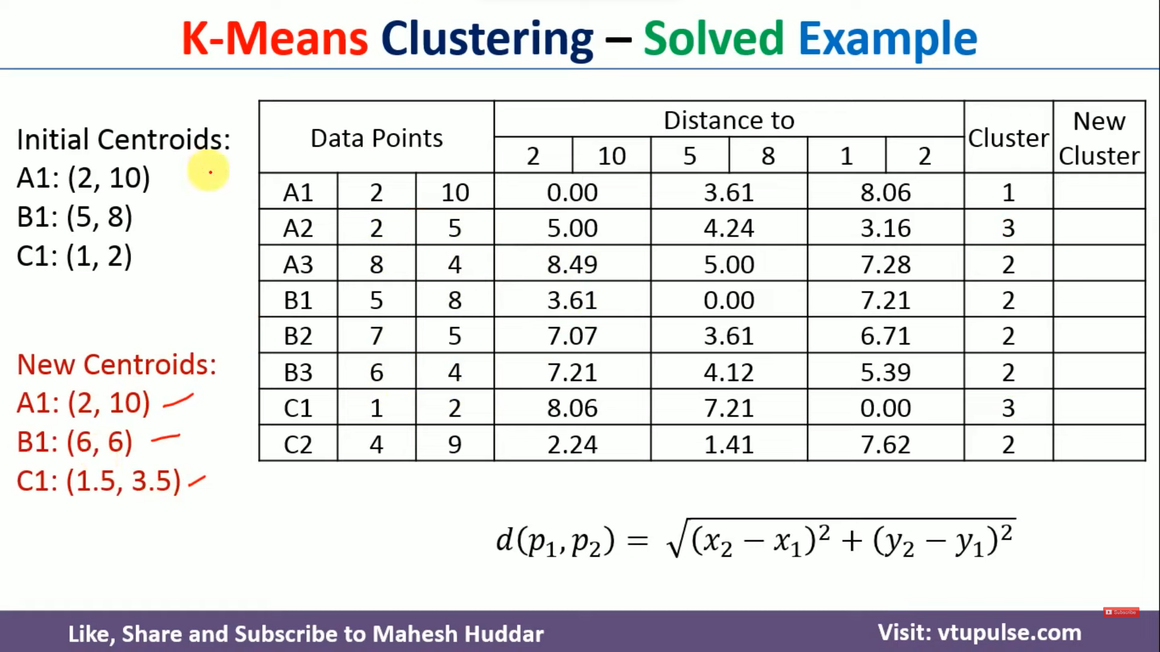

Slide 18
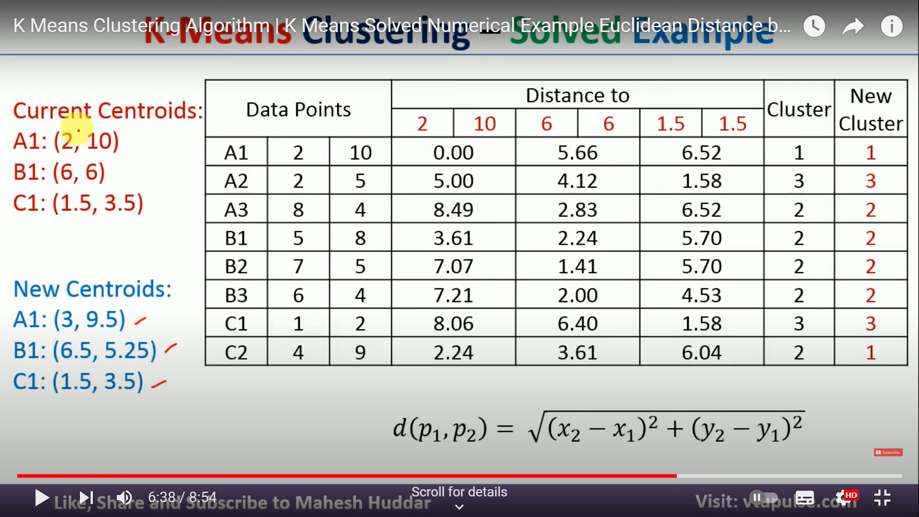

Slide 19
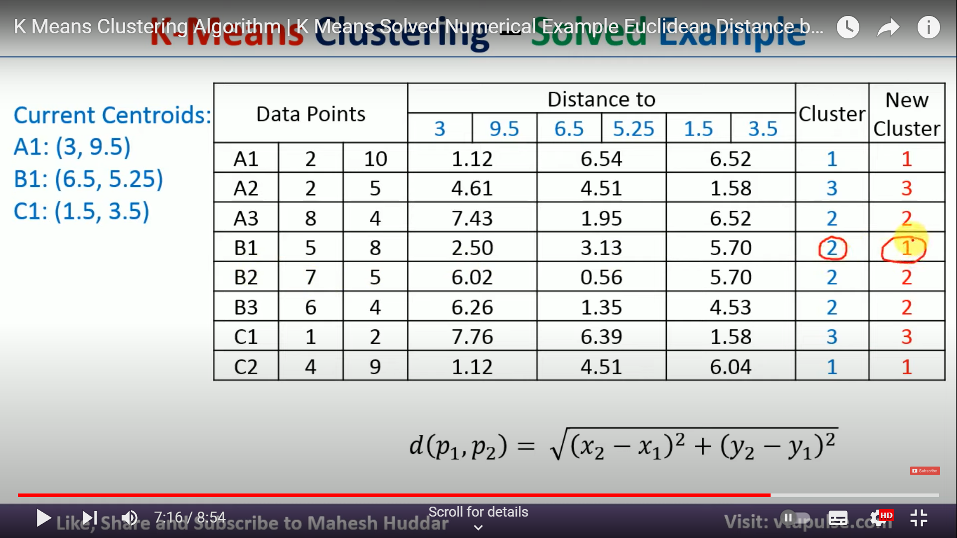

Slide 20
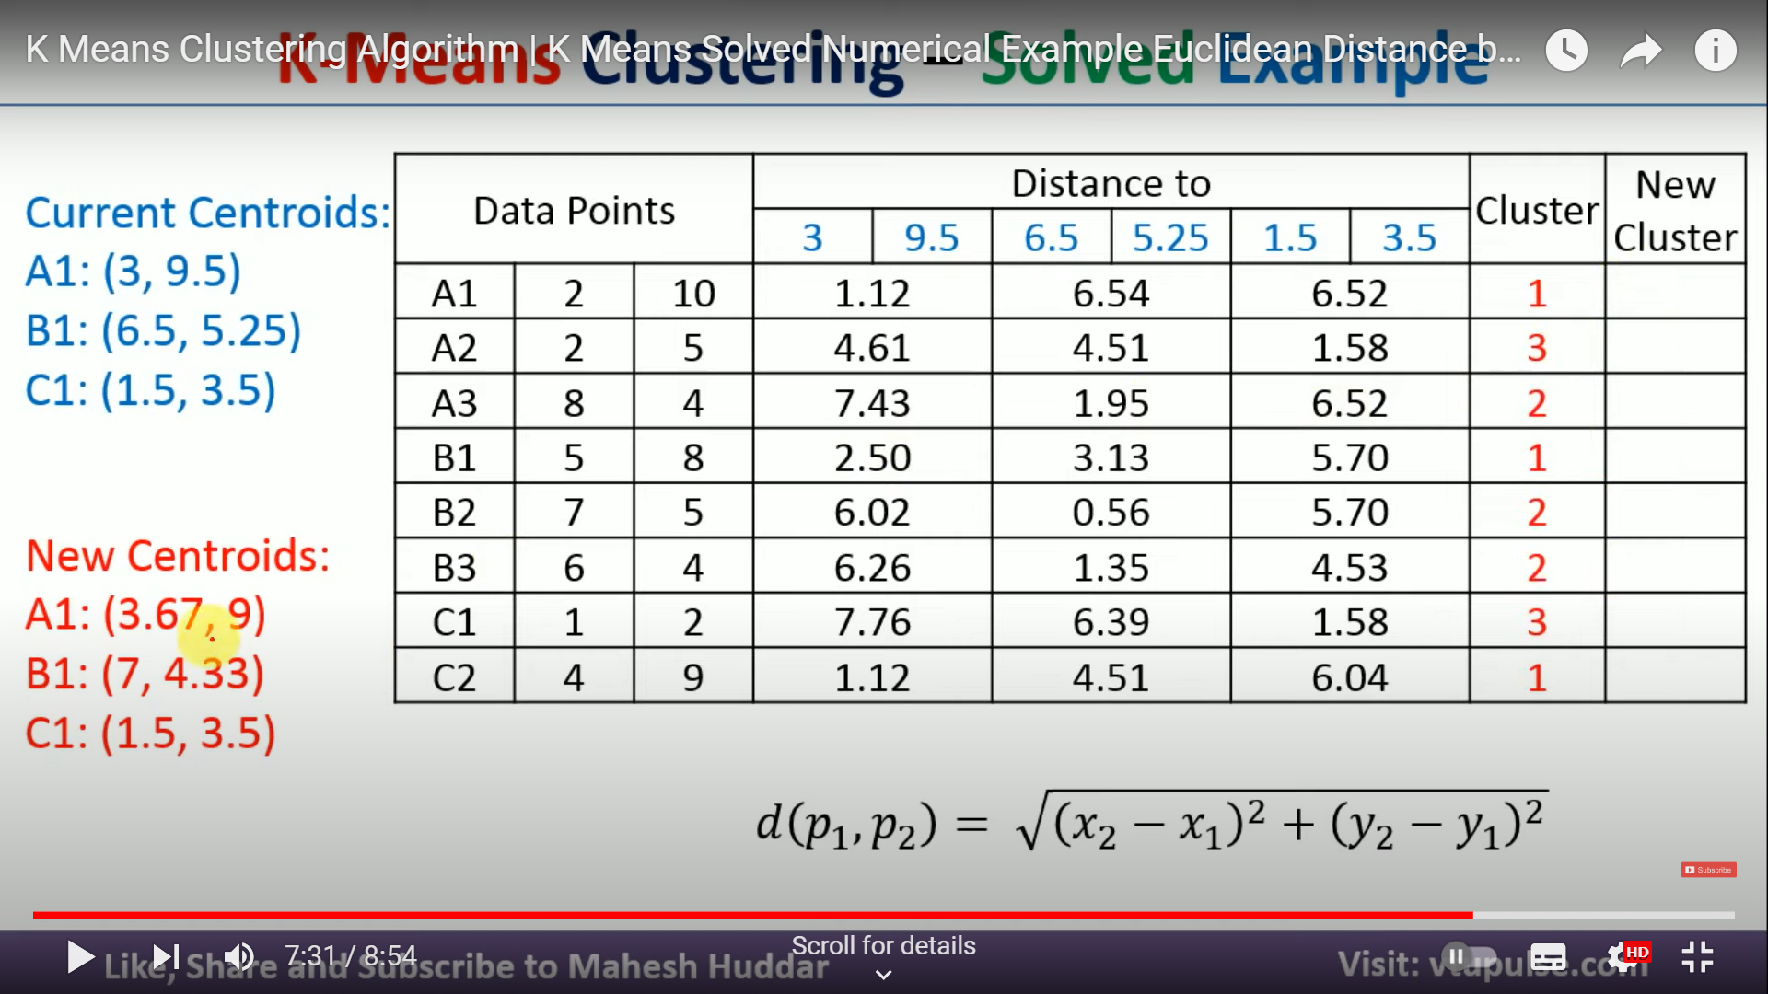

Slide 21
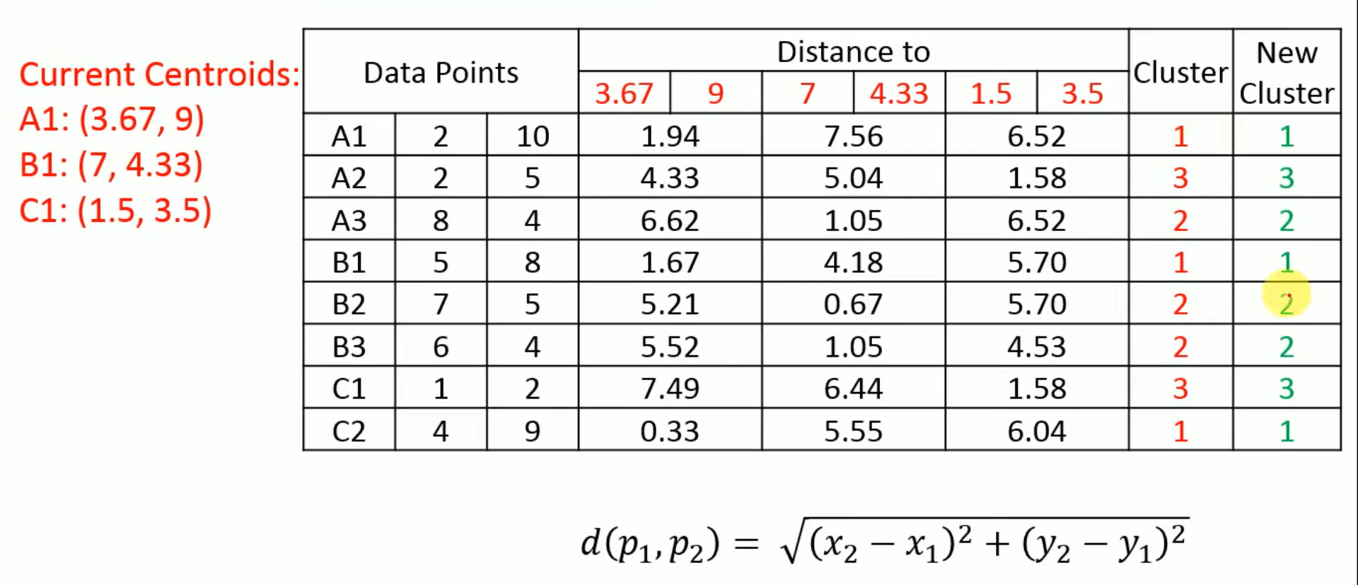

Slide 22
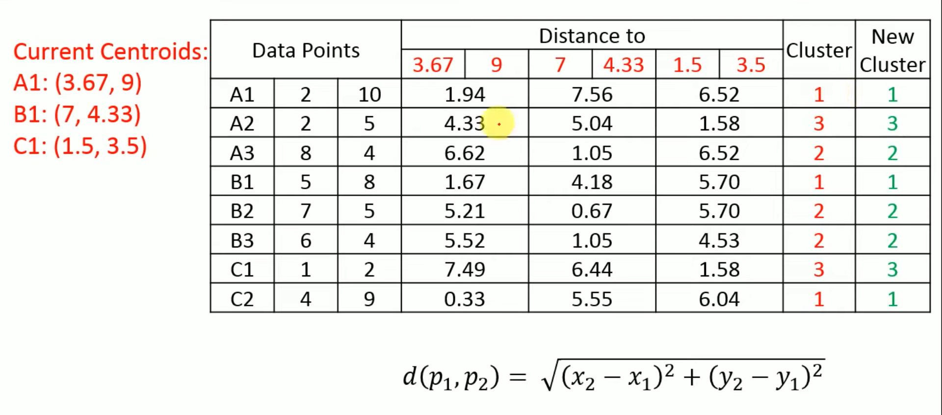

Slide 23
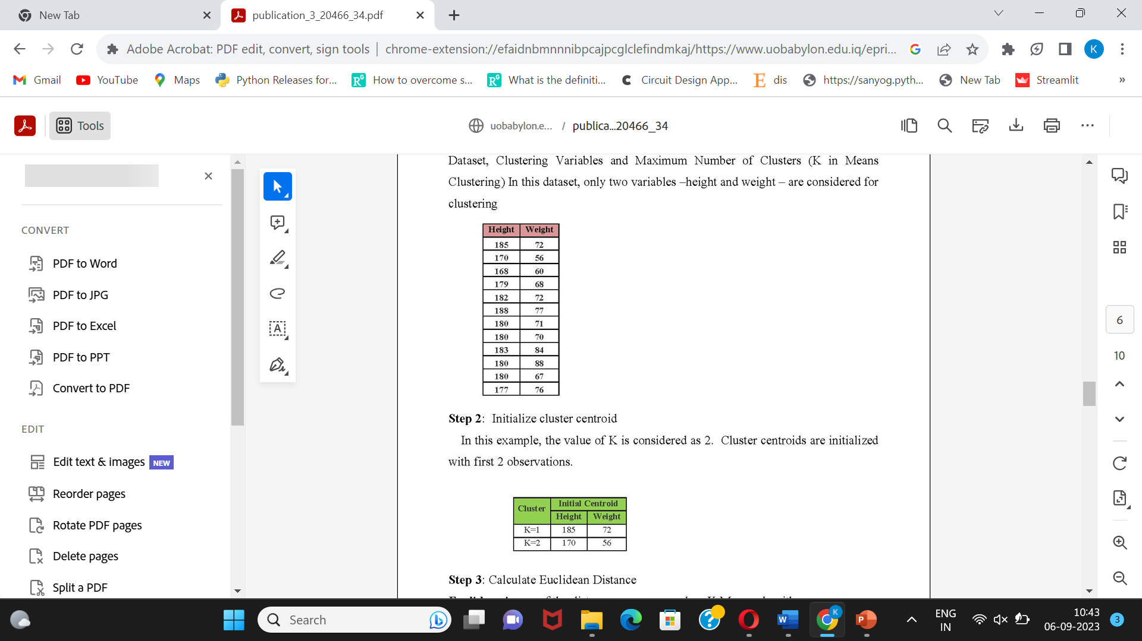

Slide 24
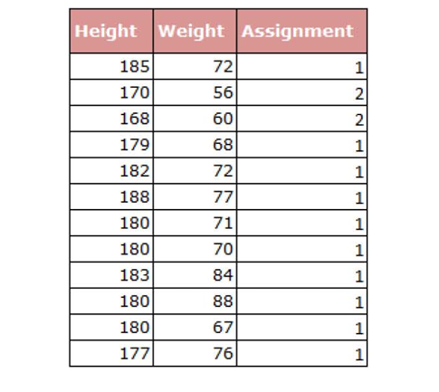

Slide 25
Hierarchical Clustering
Agglomerative (bottom up)
Start with 1 point (singleton)
Recursively add two or more appropriate clusters
Stop when k number of clusters is achieved.
Divisive (top down)
Start with a big cluster
Recursively divide into smaller clusters
Stop when k number of clusters is achieved.

Slide 26
A Dendrogram
Cluster Merging Hierarchically
Decompose data objects into several levels of nested partitioning (tree of clusters), called a Dendrogram.
A clustering of the data objects is obtained by cutting the Dendrogram at the desired level. Then each connected component forms a cluster.

Slide 27
AGNES (Agglomerative Nesting)
Produces tree of clusters (nodes)
Initially: each object is a cluster (leaf)
Recursively merges nodes that have the least dissimilarity
Criteria: min distance, max distance, avg distance, center distance
Eventually all nodes belong to the same cluster (root)

Slide 28
Hierarchical Clustering
Algorithmic steps for Agglomerative Hierarchical clustering
Let X = {x₁, x₂, x₃, ..., x_{n}} be the set of data points.
Begin with the disjoint clustering having level L(0) = 0 and sequence number m = 0.
Find the least distance pair of clusters in the current clustering, say pair (r), (s), according to d[(r),(s)] = min . d[(i),(j)] where the minimum is over all pairs of clusters in the current clustering.
Increment the sequence number: m = m +1.Merge clusters (r) and (s) into a single cluster to form the next clustering m. Set the level of this clustering to L(m) = d[(r),(s)].
Update the distance matrix, D, by deleting the rows and columns corresponding to clusters (r) and (s) and adding a row and column corresponding to the newly formed cluster. The distance between the new cluster, denoted (r,s) and old cluster(k) is defined in this way: d[(k), (r,s)] = min (d[(k),(r)], d[(k),(s)]).
If all the data points are in one cluster then stop, else repeat from step
Divisive Hierarchical clustering - It is just the reverse of Agglomerative Hierarchical approach.

Slide 29
Hierarchical Clustering
Methods-
Single Linkage Method- In single linkage, we define the distance between two clusters to be the minimum distance between any single data point in the first cluster and any single data point in the second cluster. On the basis of this definition of distance between clusters, at each stage of the process we combine the two clusters that have the smallest single linkage distance.
Complete Linkage: In complete linkage, we define the distance between two clusters to be the maximum distance between any single data point in the first cluster and any single data point in the second cluster. On the basis of this definition of distance between clusters, at each stage of the process we combine the two clusters that have the smallest complete linkage distance.
Average Linkage: In average linkage, we define the distance between two clusters to be the average distance between data points in the first cluster and data points in the second cluster. On the basis of this definition of distance between clusters, at each stage of the process we combine the two clusters that have the smallest average linkage distance.

Slide 30
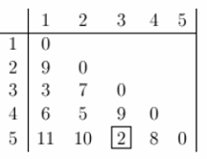
Example: Agglomerative Hierarchical Clustering

Slide 31
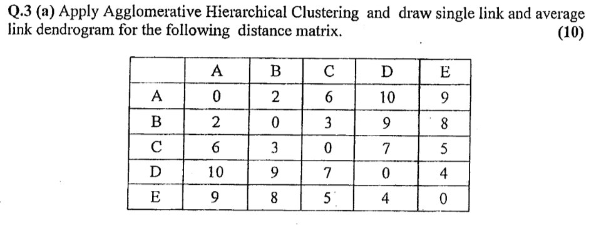
Example: Agglomerative Hierarchical Clustering

Slide 32
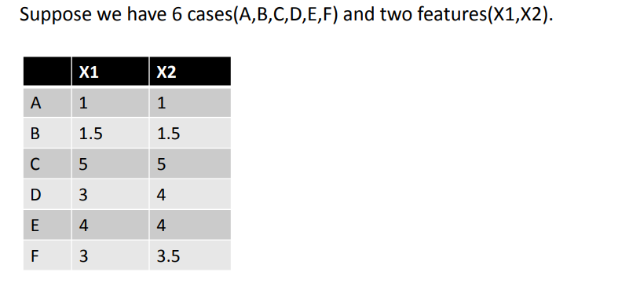
Example: Agglomerative Hierarchical Clustering

Slide 33
Divisive Analysis (DIANA)
Building MST (Minimum Spanning Tree) is a method for constructing hierarchy of clusters.
It starts with a tree that consists of a point p. In successive steps, look for the closest pair of points (p,q) such that p is in the current tree but q is not. With this closest pair of points (p,q), add q to the tree and put an edge between p and q.
The procedure of constructing hierarchy of clusters using MST would be as follows:
Construct a MST as a proximity graph
repeat
Split a cluster by breaking the inconsistent edge.
until Only singleton clusters remain

Slide 34
Other Hierarchical Clustering Methods
Major weakness of agglomerative clustering methods
Do not scale well: time complexity of at least O(n²), where n is the number of total objects
Can never undo what was done previously
Integration of hierarchical with distance-based clustering
BIRCH: uses CF-tree and incrementally adjusts the quality of sub-clusters

Slide 35
Density-Based Clustering
Clustering based on density (local cluster criterion), such as density-connected points
Major features:
Discover clusters of arbitrary shape
Handle noise
One scan
Need density parameters as termination condition
Representative algorithms:
DBSCAN (Ester et al., 1996)
OPTICS (Mihael Ankers et al., 1999)

Slide 36
DBSCAN: Density Based Spatial Clustering of Applications with Noise
An object p is in the ε-neighborhood of q if the distance from p to q is less than ε.
ε
MinPts = 3
A core object has at least MinPts in its
ε-neighborhood.
An object p is directly density-reachable from object q if q is a core object and p is in the ε-neighborhood of q.
An object p is density-reachable from object q if there is a chain of objects p₁, …, p_{n}, where p₁ = q and p_{n} = p such that p_{i+1} is directly density reachable from p_{i}.
An object p is density-connected to object q if there is an object o such that both p and q are density-reachable from o.

Slide 37
DBSCAN: Definitions (I)
Two parameters:
Eps: Maximum radius of neighborhood
MinPts: Minimum number of points in an Eps-neighborhood of a point
N_{Eps}(p) ={q Є D | dist(p,q) <= Eps}
Directly density-reachable: A point p is directly density-reachable from a point q wrt. Eps, MinPts iff
1) p belongs to N_{Eps}(q)
2) q is a core point:
|N_{Eps} (q)| >= MinPts
p
MinPts = 5
Eps = 1 cm
q

Slide 38
DBSCAN
Relies on a density-based notion of cluster: A cluster is defined as a maximal set of density-connected points
Discovers clusters of arbitrary shape in spatial databases with noise
Outlier
Border
Eps = 1cm
MinPts = 5
Core

Slide 39
DBSCAN: The Algorithm
Arbitrarily select a point p
Retrieve all points density-reachable from p wrt Eps and MinPts.
If p is a core point, a cluster is formed.
If p is a border point, no points are density-reachable from p and DBSCAN visits the next point of the database.
Continue the process until all of the points have been processed.

Slide 40
Frequent Pattern Mining

Slide 41
Basic Concepts
Frequent Pattern: a pattern (a set of items, subsequences, substructures, etc.) that occurs frequently in a data set
Goal: finding inherent regularities in data
What products were often purchased together?— Milk and Bread?!
What are the subsequent purchases after buying a PC?
What kinds of DNA are sensitive to this new drug?
Can we automatically classify Web documents?
Applications:
A typical example of frequent itemset mining is market basket analysis.
cross-marketing, catalog design, sale campaign analysis, Web log (click stream) analysis, and DNA sequence analysis.

Slide 42
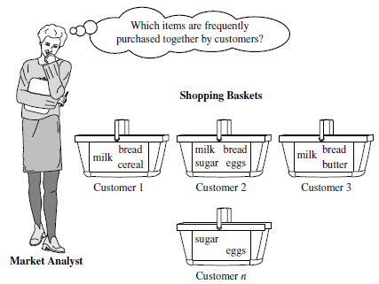
Figure 1 Market basket analysis.
First proposed by Agrawal, Imielinski, and Swami [AIS93] in the context of frequent itemsets and association rule mining

Slide 43
Frequent Patterns
Itemset X = {x₁, …, x_{k}}
Find all the rules X → Y with minimum support and confidence
support, s, probability that a transaction contains X ∪ Y
confidence, c, conditional probability that a transaction having X also contains Y
An itemset X is frequent if X’s support is no less than a minsup threshold
Tid | Items bought
10 | Milk, Bread, Cookies, Juice
20 | Milk, Juice
30 | Milk, Eggs
40 | Bread, Cookies, Coffee
Customer
buys both
Customer
buys Milk
Customer
buys Bread

Slide 44
Association Rules
Find all the rules X → Y with minimum support and confidence threshold
support , s, probability that a transaction contains X ∪ Y
confidence, c, conditional probability that a transaction having X also contains Y
Let Milk → Juice and Bread → Juice
The support of Milk→ Juice = 50% (2/4)
The Conf of Milk → Juice = 66.7% (2/3)
The support of Bread → Juice = 25% ?
The Conf of Bread → Juice = 50% ?
Rules that satisfy both minsup and minconf are called strong rules
Tid | Items bought
10 | Milk, Bread, Cookies, Juice
20 | Milk, Juice
30 | Milk, Eggs
40 | Bread, Cookies, Coffee
Customer
buys both
Customer
buys Milk
Customer
buys Bread

Slide 45
Closed Patterns and Max-Patterns
A long pattern contains a combinatorial number of sub-patterns, Ex: {a₁, …, a₁₀₀} contains (₁₀₀¹) + (₁₀₀²) + … + (₁¹₀⁰₀⁰) = 2¹⁰⁰ – 1 = 1.27*10³⁰ sub-patterns!
Solution: Mine closed patterns and max-patterns instead
An itemset X is closed if X is frequent and there exists no super-pattern Y כ X, with the same support as X
An itemset X is a max-pattern if X is frequent and there exists no frequent super-pattern Y כ X
Closed pattern is a lossless compression of freq. patterns
Reducing the number of patterns and rules

Slide 46
Closed Patterns and Max-Patterns
Example
DB = {<a₁, …, a₁₀₀>, < a₁, …, a₅₀>}
Min_sup=1
What is the set of closed itemset?
<a1, …, a100>: 1
< a1, …, a50>: 2
What is the set of max-pattern?
<a1, …, a100>: 1

Slide 47
Computational Complexity
How many itemsets are potentially to be generated in the worst case?
The number of frequent itemsets to be generated is sensitive to the minsup threshold
When minsup is low, there exist potentially an exponential number of frequent itemsets
The worst case: MN where M: # distinct items, and N: max length of transactions

Slide 48
Apriori: Concepts and Principle
The downward closure property of frequent patterns
Any subset of a frequent itemset must be frequent
If {Milk, Bread, Juice} is frequent, so is {Milk, Bread}
i.e., every transaction having {Milk, Bread, Juice} also contains {Milk, Bread}
Apriori pruning principle: If there is any itemset which is infrequent, its superset should not be generated/tested

Slide 49
Apriori Principle
Initially, scan DB once to get frequent 1-itemset
Generate length (k+1) candidate itemsets from length k frequent itemsets
Test the candidates against DB
Terminate when no frequent or candidate set can be generated

Slide 50
Apriori Algorithm

Slide 51
Apriori: Example
Sup_{min} = 2
Itemset | sup
{I1} | 2
{I2} | 3
{I3} | 3
{I4} | 1
{I5} | 3
Database
Itemset | sup
{I1} | 2
{I2} | 3
{I3} | 3
{I5} | 3
L₁
Tid | Items
10 | I1, I3, I4
20 | I2, I3, I5
30 | I1, I2, I3, I5
40 | I2, I5
C₁
1st scan
C₂
Itemset | sup
{I1, I2} | 1
{I1, I3} | 2
{I1, I5} | 1
{I2, I3} | 2
{I2, I5} | 3
{I3, I5} | 2
C₂
Itemset
{I1, I2}
{I1, I3}
{I1, I5}
{I2, I3}
{I2, I5}
{I3, I5}
L₂
Itemset | sup
{I1, I3} | 2
{I2, I3} | 2
{I2, I5} | 3
{I3, I5} | 2
2nd scan
C₃
Itemset
{I2, I3, I5}
3rd scan
L₃
Itemset | sup
{I2, I3, I5} | 2

Slide 52
Apriori Algorithm
C_{k}: Candidate itemset of size k
L_{k} : frequent itemset of size k
L₁ = {frequent items};
for (k = 1; L_{k} !=∅; k++) do begin
C_{k+1} = candidates generated from L_{k};
for each transaction t in database do
increment the count of all candidates in C_{k+1} that are contained in t
L_{k+1} = candidates in C_{k+1} with min_support
end
return ∪_{k} L_{k};

Slide 53
Candidate Generation
How to generate candidates?
Step 1: self-joining L_{k}
Step 2: pruning
Join L_{k} p with L_{k} q, as follows:
insert into C_{k+1}
select {p.item_{i}}_{{1,..,k-1}}, p.item_{k}, q.item_{k}
from L_{k} p, L_{k} q
where {p.item_{i}}_{{1,..k-1} =} {q.item_{i}} _{{1,..k-1}} and p.item_{k} < q.item_{k}

Slide 54
Example of Candidate Generation
Suppose we have the following frequent 3-itemsets and we would like to generate the 4-itemsets candidates
L3={{I1, I2, I3} , {I1, I2, I4}, {I1, I3, I4}, {I1, I3, I5}, {I2,I3,I4}}
Self-joining: L3*L3 gives:
{I1,I2,I3,I4} from {I1, I2, I3} , {I1, I2, I4}, and {I2,I3,I4}
{I1,I3,I4,I5} from {I1, I3, I4} and {I1, I3, I5}
Pruning: {I1,I3,I4,I5} is removed because {I1,I4,I5} is not in L3
C4 = {I1,I2,I3,I4}

Slide 55
Generating Association Rules
Once the frequent itemsets have been found, it is straightforward to generate strong association rules that satisfy:
minimum support
minimum confidence
Relation between support and confidence:
support_count(A∪B)
Confidence(A⇒B) = P(B|A)=
support_count(A)
Support_count(A∪B) is the number of transactions containing the itemsets A ∪ B
Support_count(A) is the number of transactions containing the itemset A.

Slide 56
Generating Association Rules
For each frequent itemset L, generate all non empty subsets of L
For every non empty subset S of L, output the rule:
S ⇒ (L-S)
If (support_count(L)/support_count(S)) >= min_conf

Slide 57
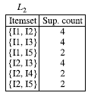
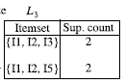
Example
Suppose the frequent Itemset L={I1,I2,I5}
Subsets of L are: {I1,I2}, {I1,I5}, {I2,I5}, {I1}, {I2},{I5}
Association rules :
I1 ∧ I2 ⇒ I5 confidence = 2/4= 50%
I1 ∧ I5 ⇒ I2 confidence=2/2=100%
I2 ∧ I5 ⇒ I1 confidence=2/2=100%
I1 ⇒ I2 ∧ I5 confidence=2/6=33%
I2 ⇒ I1 ∧ I5 confidence=2/7=29%
I5 ⇒ I2 ∧ I2 confidence=2/2=100%
If the minimum confidence =70%
Transactional Database
TID | List of item IDS
T100 | I1,I2,I5
T200 | I2,I4
T300 | I2,I3
T400 | I1,I2,I4
T500 | I1,I3
T600 | I2,I3
T700 | I1,I3
T800 | I1,I2,I3,I5
T900 | I1,I2,I3

Slide 58
Improving the Efficiency of Apriori
Major computational challenges
Huge number of candidates
Multiple scans of transaction database
Tedious workload of support counting for candidates
Improving Apriori: general ideas
Hash-based technique
Transaction reduction
Partitioning
Sampling
Dynamic itemset counting

Slide 59
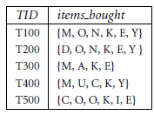
Exercises
A database has five transactions. Let min sup D 60% and min conf D 80%.
Find all frequent itemsets using Apriori.
List all the strong association rules.

Slide 60
Find all strong rules using Apriori algorithm. Let minimum support be 30% and confidence be 75%
TID | Items
T1 | E, A, D, B
T2 | D, A, C, E, B
T3 | C, A, B, E
T4 | B, A, D
T5 | D
T6 | D, B
T7 | A, D, E
T8 | B, C

Slide 61
FP-growth: Frequent Pattern-Growth
Adopts a divide and conquer strategy
Compress the database representing frequent items into a frequent –pattern tree or FP-tree
Retains the itemset association information
Divid the compressed database into a set of conditional databases, each associated with one frequent item
Mine each such databases separately

Slide 62
Example: FP-growth
The first scan of data is the same as Apriori
Derive the set of frequent 1-itemsets
Let min-sup=2
Generate a set of ordered items
Transactional Database
TID | List of item IDS
T100 | I1,I2,I5
T200 | I2,I4
T300 | I2,I3
T400 | I1,I2,I4
T500 | I1,I3
T600 | I2,I3
T700 | I1,I3
T800 | I1,I2,I3,I5
T900 | I1,I2,I3
Item ID | Support count
I2 | 7
I1 | 6
I3 | 6
I4 | 2
I5 | 2

Slide 63
Construct the FP-Tree
Transactional Database
TID | Items | TID | Items | TID | Items
T100 | I1,I2,I5 | T400 | I1,I2,I4 | T700 | I1,I3
T200 | I2,I4 | T500 | I1,I3 | T800 | I1,I2,I3,I5
T300 | I2,I3 | T600 | I2,I3 | T900 | I1,I2,I3
- Create a branch for each transaction
- Items in each transaction are processed in order
1- Order the items T100: {I2,I1,I5}
2- Construct the first branch:
<I2:1>, <I1:1>,<I5:1>
null
Item ID | Support count
I2 | 7
I1 | 6
I3 | 6
I4 | 2
I5 | 2
I2:1
I1:1
I5:1

Slide 64
Construct the FP-Tree
Transactional Database
TID | Items | TID | Items | TID | Items
T100 | I1,I2,I5 | T400 | I1,I2,I4 | T700 | I1,I3
T200 | I2,I4 | T500 | I1,I3 | T800 | I1,I2,I3,I5
T300 | I2,I3 | T600 | I2,I3 | T900 | I1,I2,I3
- Create a branch for each transaction
- Items in each transaction are processed in order
1- Order the items T200: {I2,I4}
2- Construct the second branch:
<I2:1>, <I4:1>
null
Item ID | Support count
I2 | 7
I1 | 6
I3 | 6
I4 | 2
I5 | 2
I2:2
I2:1
I1:1
I4:1
I5:1

Slide 65
Construct the FP-Tree
Transactional Database
TID | Items | TID | Items | TID | Items
T100 | I1,I2,I5 | T400 | I1,I2,I4 | T700 | I1,I3
T200 | I2,I4 | T500 | I1,I3 | T800 | I1,I2,I3,I5
T300 | I2,I3 | T600 | I2,I3 | T900 | I1,I2,I3
- Create a branch for each transaction
- Items in each transaction are processed in order
1- Order the items T300: {I2,I3}
2- Construct the third branch:
<I2:2>, <I3:1>
null
Item ID | Support count
I2 | 7
I1 | 6
I3 | 6
I4 | 2
I5 | 2
I2:2
I2:3
I1:1
I4:1
I3:1
I5:1

Slide 66
Construct the FP-Tree
Transactional Database
TID | Items | TID | Items | TID | Items
T100 | I1,I2,I5 | T400 | I1,I2,I4 | T700 | I1,I3
T200 | I2,I4 | T500 | I1,I3 | T800 | I1,I2,I3,I5
T300 | I2,I3 | T600 | I2,I3 | T900 | I1,I2,I3
- Create a branch for each transaction
- Items in each transaction are processed in order
1- Order the items T400: {I2,I1,I4}
2- Construct the fourth branch:
<I2:3>, <I1:1>,<I4:1>
null
Item ID | Support count
I2 | 7
I1 | 6
I3 | 6
I4 | 2
I5 | 2
I2:4
I2:3
I1:2
I4:1
I1:1
I3:1
I5:1
I4:1

Slide 67
Construct the FP-Tree
Transactional Database
TID | Items | TID | Items | TID | Items
T100 | I1,I2,I5 | T400 | I1,I2,I4 | T700 | I1,I3
T200 | I2,I4 | T500 | I1,I3 | T800 | I1,I2,I3,I5
T300 | I2,I3 | T600 | I2,I3 | T900 | I1,I2,I3
- Create a branch for each transaction
- Items in each transaction are processed in order
1- Order the items T400: {I1,I3}
2- Construct the fifth branch:
<I1:1>, <I3:1>
null
Item ID | Support count
I2 | 7
I1 | 6
I3 | 6
I4 | 2
I5 | 2
I1:1
I2:4
I1:2
I4:1
I3:1
I3:1
I5:1
I4:1

Slide 68
Construct the FP-Tree
Transactional Database
TID | Items | TID | Items | TID | Items
T100 | I1,I2,I5 | T400 | I1,I2,I4 | T700 | I1,I3
T200 | I2,I4 | T500 | I1,I3 | T800 | I1,I2,I3,I5
T300 | I2,I3 | T600 | I2,I3 | T900 | I1,I2,I3
null
I2:7
I1:2
Item ID | Support count
I2 | 7
I1 | 6
I3 | 6
I4 | 2
I5 | 2
I1:4
I4:1
I3:2
I3:2
I5:1
I4:1
When a branch of a transaction is added, the count for each node along a common prefix is incremented by 1
I3:2
I5:1

Slide 69
Construct the FP-Tree
null
I2:7
I1:2
Item ID | Support count
I2 | 7
I1 | 6
I3 | 6
I4 | 2
I5 | 2
I1:4
I4:1
I3:2
I3:2
I5:1
I4:1
I3:2
I5:1
The problem of mining frequent patterns in databases is transformed to that of mining the FP-tree

Slide 70
Construct the FP-Tree
null
I2:7
I1:2
Item ID | Support count
I2 | 7
I1 | 6
I3 | 6
I4 | 2
I5 | 2
I1:4
I4:1
I3:2
I3:2
I5:1
I4:1
I3:2
I5:1
-Occurrences of I5: <I2,I1,I5> and <I2,I1,I3,I5>
-Two prefix Paths <I2, I1: 1> and <I2,I1,I3: 1>
-Conditional FP tree contains only <I2: 2, I1: 2>, I3 is not considered because its support count of 1 is less than the minimum support count.
-Frequent patterns {I2,I5:2}, {I1,I5:2},{I2,I1,I5:2}

Slide 71
Construct the FP-Tree
null
I2:7
I1:2
Item ID
Support count
I2
7
I1:4
I4:1
I1
6
I3:2
I3:2
I3
6
I5:1
I4
2
I4:1
I5
2
I3:2
I5:1
TID | Conditional Pattern Base | Conditional FP-tree
I5 | {{I2,I1:1},{I2,I1,I3:1}} | <I2:2,I1:2>
I4 | {{I2,I1:1},{I2,1}} | <I2:2>
I3 | {{I2,I1:2},{I2:2}, {I1:2}} | <I2:4,I1:2>,<I1:2>
I1 | {I2,4} | <I2:4>

Slide 72
Construct the FP-Tree
null
I2:7
I1:2
Item ID
Support count
I2
7
I1:4
I4:1
I1
6
I3:2
I3:2
I3
6
I5:1
I4
2
I4:1
I5
2
I3:2
I5:1
TID | Conditional FP-tree | Frequent Patterns Generated
I5 | <I2:2,I1:2> | {I2,I5:2}, {I1,I5:2},{I2,I1,I5:2}
I4 | <I2:2> | {I2,I4:2}
I3 | <I2:4,I1:2>,<I1:2> | {I2,I3:4},{I1,I3:4},{I2,I1,I3:2}
I1 | <I2:4> | {I2,I1:4}

Slide 73
FP-growth properties
FP-growth transforms the problem of finding long frequent patterns to searching for shorter once recursively and concatenating the suffix
It uses the least frequent suffix offering a good selectivity
It reduces the search cost
If the tree does not fit into main memory, partition the database
Efficient and scalable for mining both long and short frequent patterns

Slide 74
FP Mining with Vertical Data Format
Both Apriori and FP-growth use horizontal data format
Alternatively data can also be
represented in vertical format
TID | List of item IDS
T100 | I1,I2,I5
T200 | I2,I4
T300 | I2,I3
T400 | I1,I2,I4
T500 | I1,I3
T600 | I2,I3
T700 | I1,I3
T800 | I1,I2,I3,I5
T900 | I1,I2,I3
itemset | TID_set
I1 | {T100,T400,T500,T700,T800,T900}
I2 | {T100,T200,T300,T400,T600,T800,T900}
I3 | {T300,T500,T600,T700,T800,T900}
I4 | {T200,T400}
I5 | {T100,T800}

Slide 75
Example
Transform the horizontally formatted data to the vertical format by scanning the database once
The support count of an itemset is simply the length of the TID_set of the itemset
TID | List of item IDS
T100 | I1,I2,I5
T200 | I2,I4
T300 | I2,I3
T400 | I1,I2,I4
T500 | I1,I3
T600 | I2,I3
T700 | I1,I3
T800 | I1,I2,I3,I5
T900 | I1,I2,I3
itemset | TID_set
I1 | {T100,T400,T500,T700,T800,T900}
I2 | {T100,T200,T300,T400,T600,T800,T900}
I3 | {T300,T500,T600,T700,T800,T900}
I4 | {T200,T400}
I5 | {T100,T800}

Slide 76
Example …
Frequent 1-itemsets in vertical format
itemset | TID_set
I1 | {T100,T400,T500,T700,T800,T900}
I2 | {T100,T200,T300,T400,T600,T800,T900}
I3 | {T300,T500,T600,T700,T800,T900}
I4 | {T200,T400}
I5 | {T100,T800}
min_sup=2
The frequent k-itemsets can be used to construct the candidate (k+1)-itemsets based on the Apriori property
Frequent 2-itemsets in vertical format
itemset | TID_set
{I1,I2} | {T100,T400,T800,T900}
{I1,I3} | {T500,T700,T800,T900}
{I1,I4} | {T400}
{I1,I5} | {T100,T800}
{I2,I3} | {T300,T600,T800,T900}
{I2,I4} | {T200,T400}
{I2,I5} | {T100,T800}
{I3,I5} | {T800}

Slide 77
Example …
Frequent 3-itemsets in vertical format
itemset | TID_set
{I1,I2,I3} | {T800,T900}
{I1,I2,I5} | {T100,T800}
min_sup=2
This process repeats, with k incremented by 1 each time, until no frequent items or no candidate itemsets can be found
Properties of mining with vertical data format
Take the advantage of the Apriori property in the generation of candidate (k+1)-itemset from k-itemsets
No need to scan the database to find the support of (k+1) itemsets, for k>=1
The TID_set of each k-itemset carries the complete information required for counting such support
The TID-sets can be quite long, hence expensive to manipulate
Use diffset technique to optimize the support count computation

Slide 78
Strong Rules Are Not Necessarily Interesting
Whether a rule is interesting or not can be assessed either subjectively or objectively
Objective interestingness measures can be used as one step toward the goal of finding interesting rules for the user
Example of a misleading “strong” association rule
Analyze transactions of AllElectronics data about computer games and videos
Of the 10,000 transactions analyzed
6,000 of the transactions include computer games
7,500 of the transactions include videos
4,000 of the transactions include both
Suppose that min_sup=30% and min_confidence=60%
The following association rule is discovered:
Buys(X, “computer games”) ⇒ buys(X, “videos”)[support =40%, confidence=66%]

Slide 79
Strong Rules Are Not Necessarily Interesting
Buys(X, “computer games”) ⇒ buys(X, “videos”)[support 40%, confidence=66%]
This rule is strong but it is misleading
The probability of purshasing videos is 75% which is even larger than 66%
In fact computer games and videos are negatively associated because the purchase of one of these items actually decreases the likelihood of purchasing the other
The confidence of a rule A ⇒ B can be deceiving
It is only an estimate of the conditional probability of itemset B given itemset A.
It does not measure the real strength of the correlation implication between A and B
Need to use Correlation Analysis

Slide 80
From Association to Correlation Analysis
Use Lift, a simple correlation measure
The occurrence of itemset A is independent of the occurrence of itemset B if P(A∪B)=P(A)P(B), otherwise itemsets A and B are dependent and correlated as events
The lift between the occurences of A and B is given by
Lift(A,B)=P(A∪B)/P(A)P(B)
If > 1, then A and B are positively correlated (the occurrence of one implies the occurrence of the other)
If <1, then A and B are negatively correlated
If =1, then A and B are independent
Example: P({game, video})=0.4/(0.60 × 0.75)=0.89

Slide 81
Books
Text Books:
1. Han, Kamber, "Data Mining Concepts and Techniques", Morgan Kaufmann 3nd Edition
2. P. N. Tan, M. Steinbach, Vipin Kumar, “Introduction to Data Mining”, Pearson Education
3. M. H. Dunham, Data Mining Techniques and Algorithms”, Prentice Hall-2000.

